Slide 1
Volunteer Management System
Presented by Team SE18-08S

Slide 2
Agenda
Project Revisit
Use Case Modeling
Software Architecture
Demo of Prototype
Transition Strategy
Project Progress
Challenges & Problems
Q & A

Slide 3
Project Revisit
Purpose: To build a web-based solution to facilitate the process of volunteer registration, project management till retention.
Requirement overview:
Volunteer Management
Staff Management
Project Management
Itinerary Management
Administration

Slide 4
Agenda
Project Revisit
Use Case Modeling
Software Architecture
Demo of Prototype
Transition Strategy
Project Progress
Development Plan
Challenges & Problems
Q & A

Slide 5
Use Case Modeling
Use Case Model Survey:
23 use cases
7 actors
Sample Use Cases:
Search Project Member
Assign Role to Project Member
Generate Certificate

Slide 6
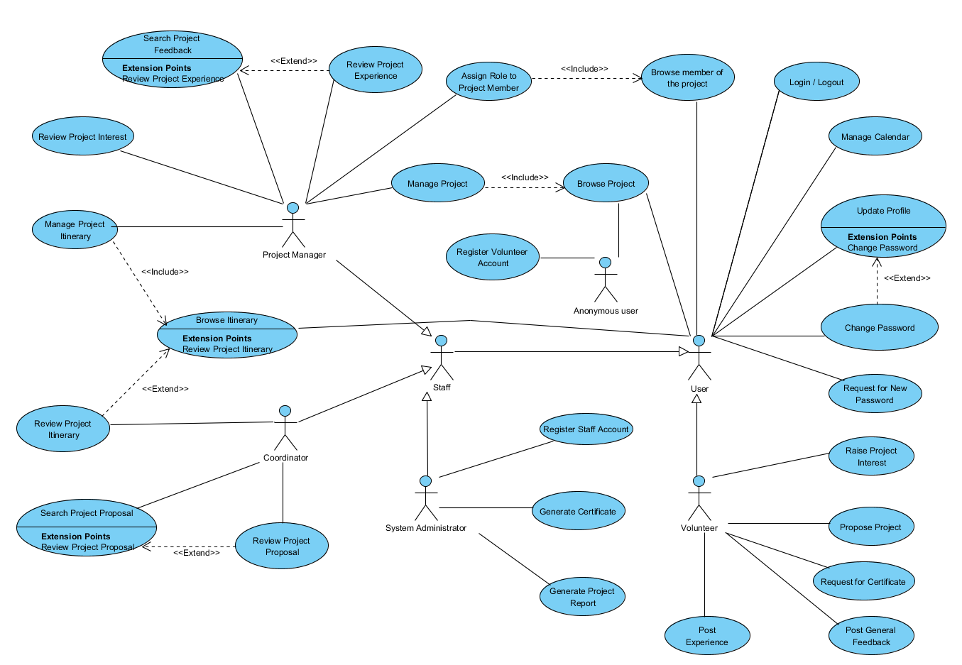

Slide 7
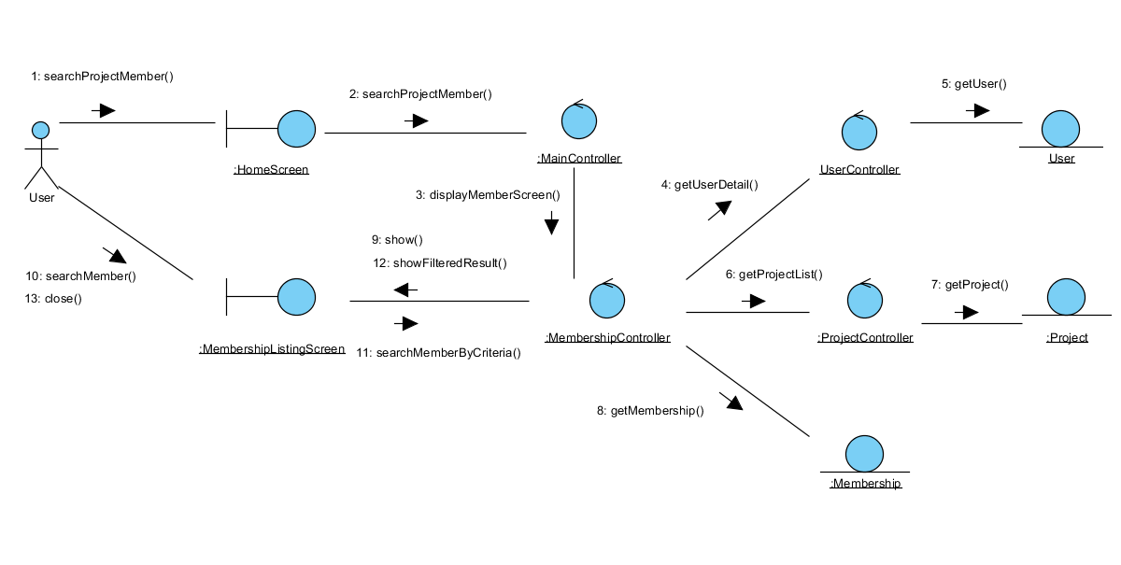
Use Case Modeling Sample 1: Search Project Member
Description: Let user search and view the member list of a project.
Interaction diagram

Slide 8
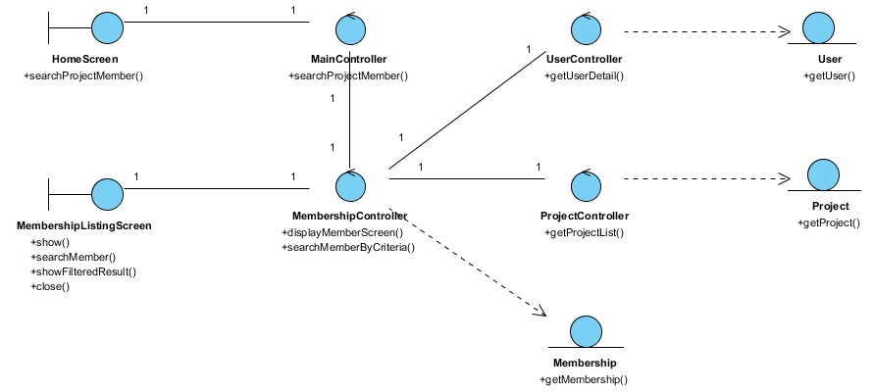
Use Case Modeling Sample 1: Search Project Member
Class diagram

Slide 9
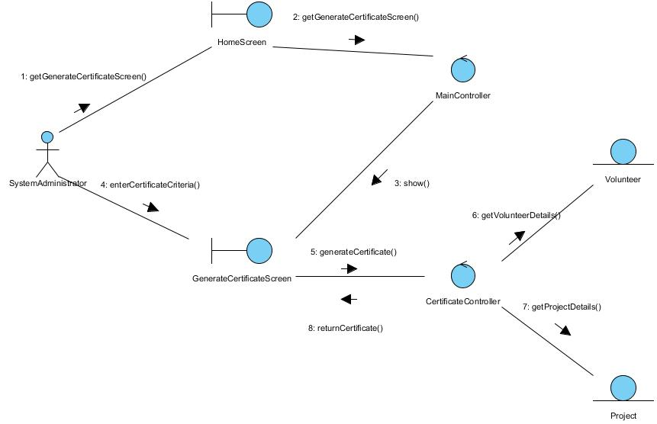
Use Case Modeling Sample 2: Generate Certificate
Description: Let user search and view the member list of a project.
Interaction diagram

Slide 10
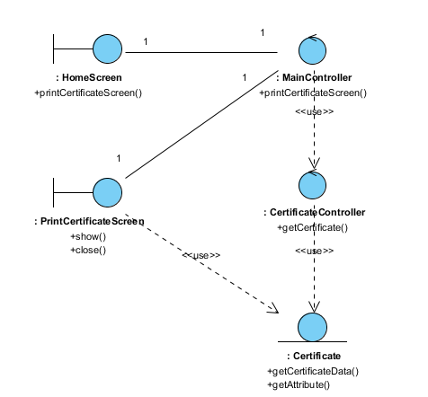
Use Case Modeling Sample 2: Generate Certificate
Class diagram

Slide 11
Agenda
Project Revisit
Use Case Modeling
Software Architecture
Demo of Prototype
Transition Strategy
Project Progress
Development Plan
Challenges & Problems
Q & A

Slide 12
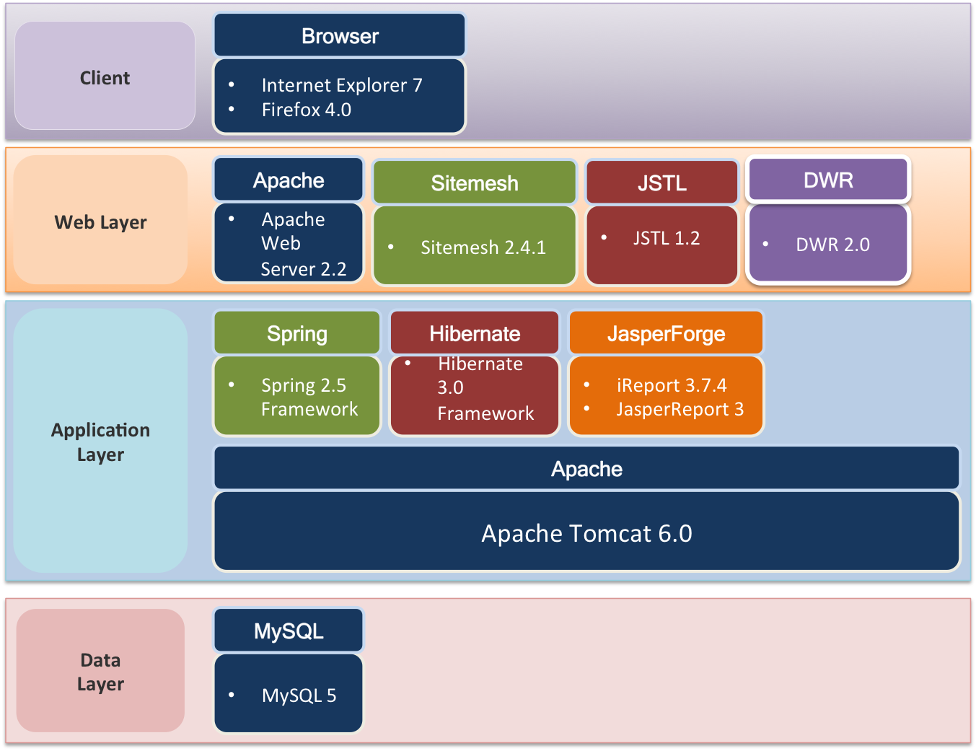
Software Architecture – Technologies & Components

Slide 13
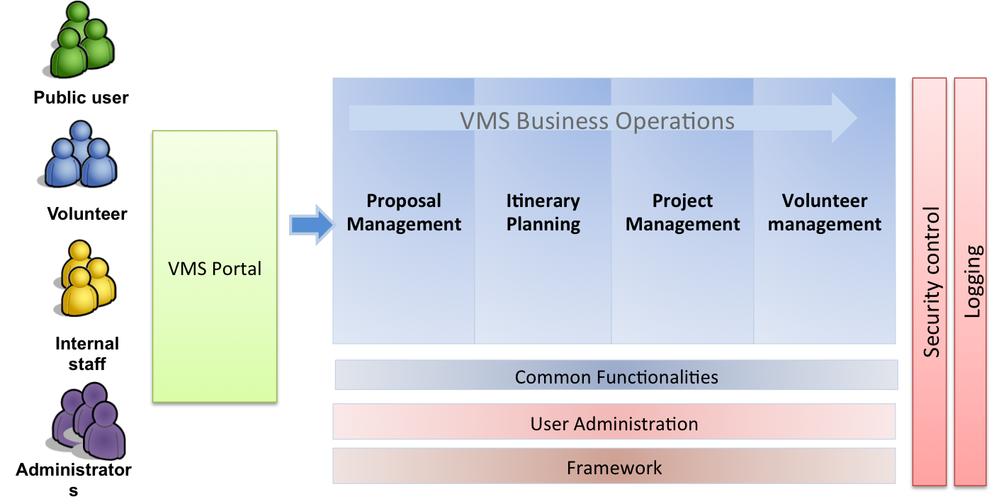
Software Architecture – Logical Application Architecture

Slide 14
Agenda
Project Revisit
Use Case Modeling
Software Architecture
Demo of Prototype
Transition Strategy
Project Progress
Development Plan
Challenges & Problems
Q & A

Slide 15
Demo of Prototype
Volunteer Management System

Slide 16
Demo of Prototype
Technical Prototype:
Purpose:
Confirm system components working
Confirm feasibility and reusability
Result:
Verified and accepted within team
User Interface Prototype
Purpose:
Review usability
Confirm UI design with user
Result:
Verified and accepted by user representative

Slide 17
Agenda
Project Revisit
Use Case Modeling
Software Architecture
Demo of Prototype
Transition Strategy
Project Progress
Development Plan
Challenges & Problems
Q & A

Slide 18
Transition Strategy – Analysis to Design
RUP workflows & process
Prototyping
Use Case Modeling
Use Case Realisation Report
High-level System Design
Detailed Design
Implementation
Testing
Project Management

Slide 19
Transition Strategy – Analysis to Design
No | Task | Description | In-Charge
1 | High level design | Software architecture Prototype | Architect Design team
2 | Detailed Design Specs | Use Case Realisation Report (Designed) Guidelines & standards | Architect Design team
3 | Implementation | Code Unit-test | Development team
4 | Testing | Test script (SIT & UAT) Test plan Test result | Test lead Test team
5 | Project Management | Development plan Project reports User guide | Project Manager QA Manager Business Analyst

Slide 20
Agenda
Project Revisit
Use Case Modeling
Software Architecture
Demo of Prototype
Transition Strategy
Project Progress
Development Plan
Challenges & Problems
Q & A

Slide 21

Project Progress
Activity | Planned Start Date | Planned End Date | Actual Start Date | Actual End Date | Task Status
Analysis Modelling
Produce Functional Specs - UCMS and UCRR (Analysis) | 10 Apr 2011 | 10 Aug 2011 | 12 Apr 2011 | 18 Aug 2011
Produce High-level Design Specifications | 1 Jul 2011 | 10 Aug 2011 | 25 May 2011 | 10 Aug 2011
Produce Prototyping Study Report | 10 Apr 2011 | 12 Jun 2011 | 01 May 2011 | 18 Aug 2011
Prepare Second Audit & Presentation | 01 Aug 2011 | 12 Aug 2011 | 01 Aug 2011 | 12 Aug 2011
Design Modelling
Produce detailed DS | 18 Aug 2011 | 15 Sep 2011 | - | - | OPEN

Slide 22
Agenda
Project Revisit
Use Case Modeling
Software Architecture
Demo of Prototype
Transition Strategy
Project Progress
Development Plan
Challenges & Problems
Q & A

Slide 23
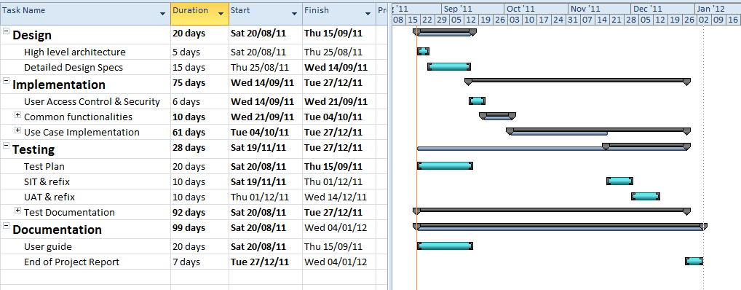
Development plan

Slide 24
Agenda
Project Revisit
Use Case Modeling
Software Architecture
Demo of Prototype
Transition Strategy
Project Progress
Development Plan
Challenges & Problems
Q & A

Slide 25
Challenges & Problems
No | Challenge | Description | Solution
1. | Communications | Difficulty to gather all members for discussions. | Online meeting via Skype To fix a weekly meeting time
2. | Task Control | Visibility of task status. | To log time log Regular status update
3. | Standard & Quality variance | Different familiarity level within the team | Guidance from lead Peer reviews Code walkthrough Pair development

Slide 26
Agenda
Project Revisit
Use Case Modeling
Software Architecture
Demo of Prototype
Transition Strategy
Project Progress
Challenges & Problems
Q & A

Slide 27
Question & Answer

